Slide 2
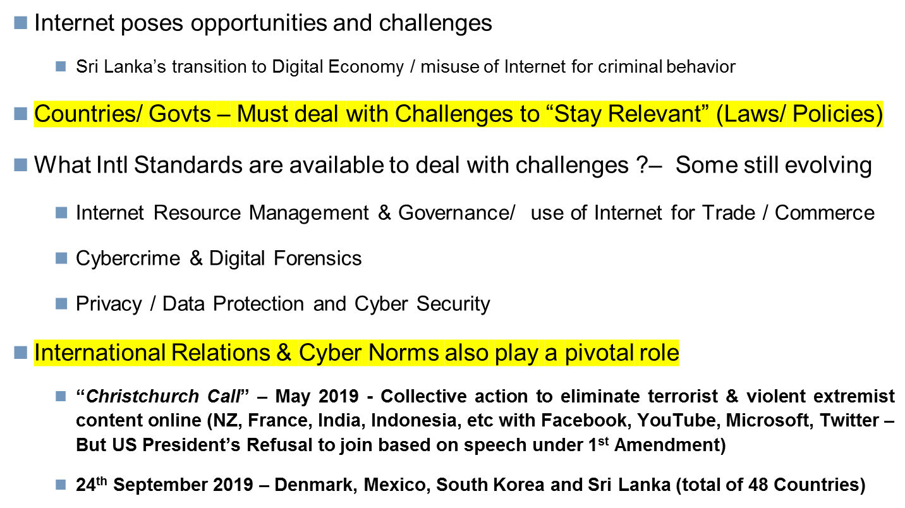
  Overview

Slide 3
  Impact of Internet
  Sri Lanka’s Transition to Digital Economy
  Internet has boosted Sri Lanka’s growth potential
  First in South Asia to Introduce competition (Telecommunications Act 1991/1996) & Liberalise Telecom Sector (1997) – Competitive mobile operations, ISPs, several Internet gateways
  Mobile Usage – Over 120% usage
    1st in South Asia to introduce 4G, Test 5G & first to introduce Mobile Payment License
  Internet Contributor to Economic growth – 30% per annum growth in BPM workforce & 5th Largest Revenue Earner
  Sri Lanka ranked No 1 in South Asia in Networked Readiness Index (NRI)
  Internet growth helping Sri Lanka’s economy – A safe, secure and stable Internet with essential freedoms an imperative

Slide 4
Digital Transactions & Commerce
Positive impact of Intl Laws
(Nations States Collectively developed International Norms & Standards in the form of Treaties)

Slide 5






Digital Transactions Actors
Defining Legal norms and standards ?
Business (B)
Consumers (C)
Government (G)

Slide 6
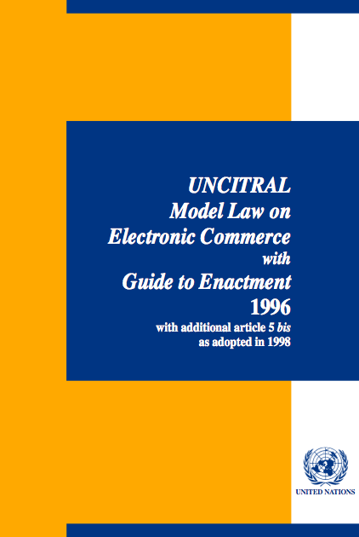
UNCITRAL Model Law on Electronic Commerce
(MLEC) – Predates the Internet
MLEC was intended to facilitate electronic means of communications and storage of information.
Based on functional equivalence in electronic media for paper-based concepts such as "writing", "signature" and "original".
Also establishes rules for the formation and validity of contracts concluded electronically and for the attribution and retention of data messages.
More information www.uncitral.org/uncitral/en/uncitral_texts/electronic_commerce/1996Model.html
Used by over 60 Countries as a Guide
Does not create binding obligations between States

Slide 7
UNCITRAL Model Law on Electronic Signatures (2001)
The MLES establishes criteria for the equivalence between electronic and hand-written signatures based on a “two-tier” approach as well as liability rules for the parties involved in the signature process.
The MLES contains provisions favoring the recognition of foreign electronic signatures based on a principle of substantive equivalence that does not take into account the place of origin.
Adopted in at least 30 States

Slide 8
Results of UNCITRAL Model Laws
Countries adopted various standards from Model Law templates
No Harmonization between Countries
Lack of uniformity in global e-Commerce Legislation
E-Signatures – Lack of Interoperability
Barrier to International e-Commerce

Slide 9
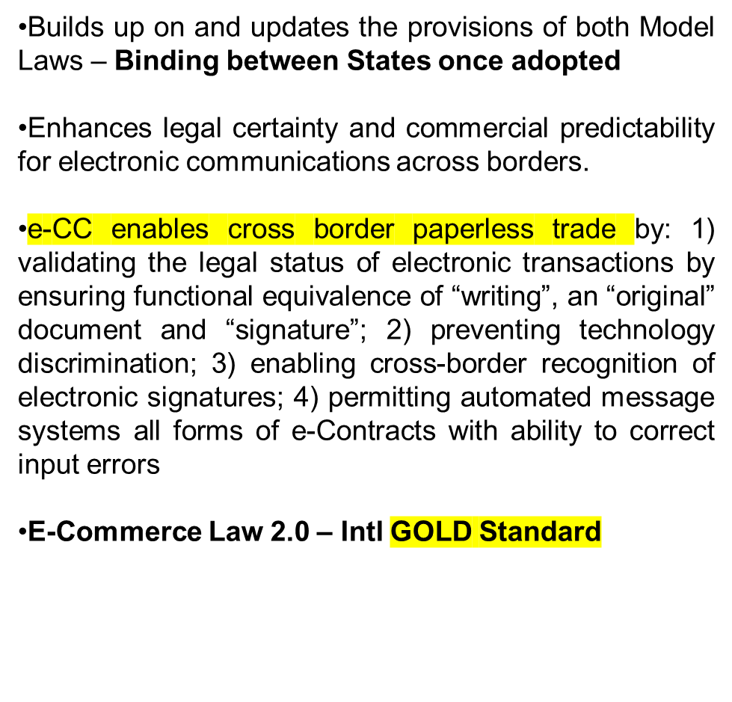
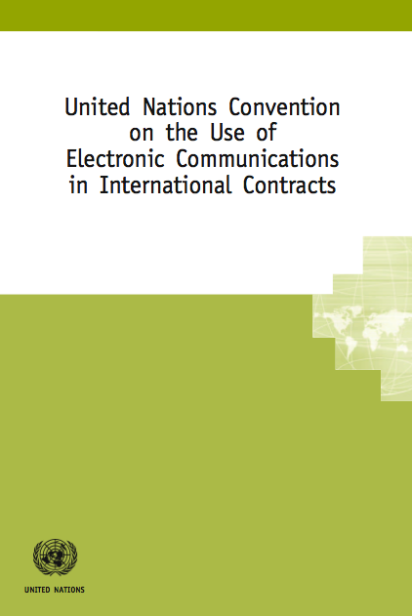
UN Electronic Communications Convention
(e-CC)
Only International Treaty on Electronic Transactions

Slide 10
Status of e-CC adoption
Dominican Republic, Honduras, Montenegro, Russia
Asia Pacific Region :
  Singapore, Sri Lanka and Fiji are state parties;
  China is a signatory and working towards ratification
  Republic of Korea is a signatory;
  The Philippines is a signatory;
  Thailand has announced accession;
  Viet Nam as enacted substantive provisions of the Convention and is considering accession.
  Australia has announced accession to e-CC;
    <http://www.ags.gov.au/publications/commercial-notes/CN30.pdf
The USA is “considering” accession
    <https://www.whitehouse.gov/the-press-office/2016/02/10/message-senate-un-convention-use-electronic-communications-international

Slide 11
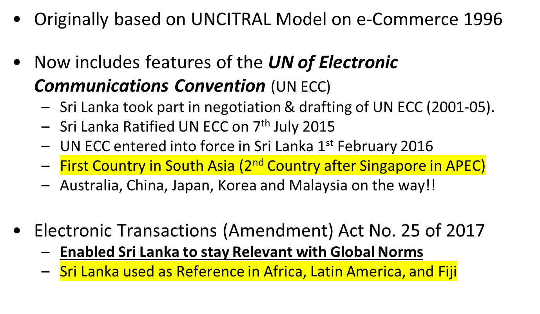
  Electronic Transactions Act No. 19 of 2006
  Sri Lanka

Slide 12
  UN ECC & Electronic Transactions Act
  Amendments (2017)
ETA Amendments No. 25 of 2017 – Greater confidence for e-Commerce
  Definitions in ETA similar to UN ECC
  “Location of Party’s business” (Not dependent on factors like domain address, location of servers and place where system is accessed)
  “Technology Neutrality for e-Signatures” & Cross border recognition
    Broader Definition and Concepts
  Greater clarity for “dispatch & receipt of a communication”
  Online Web based Sales – “Invitation to make offers”
  Use of “automated message systems” for Contract formation
  Ability to “correct input errors”

Slide 13
  ETA & Recent Amendments in Sri Lanka
  Conclusions
Recognition of having modernised e-Commerce legislation
Provide ultimate legal certainty to cross border Digital Contracts when a party is located in Sri Lanka
  Would help market Sri Lanka more effectively for FDI
Bring clarity and predictability to the use of electronic communications in cross border trade with other contracting states
  Facilitating cross border remittances through Electronic Payments channels, thus ensuring administrative efficiency
  Cross border mobile commerce
Create more binding uniform framework between Singapore, Australia, China etc -UN ESCAP Framework Agreement
Legal Basis for Singapore – Sri Lanka FTA (eCommerce Chapter)
  Mutual legal recognition of Electronic Signatures

Slide 14
Digital Contracts & Payments
Mobile Payment Regime
Mobile Commerce influenced by the Electronic Transactions Act No. 19 of 2006
Payment & Settlement System Act No. 28 of 2005
  SLIPS and CITS
  Mobile Payments Regulated under Mobile Payment Guidelines No. 1 and 2 of 2011 issued pursuant to Regulations under Payment and Settlement Systems Act No. 28 of 2005
  Mobile Payment Guidelines No 1 of 2011
    Governs Bank-led Mobile Payment Services
  Mobile Payment Guidelines No. 2 of 2011
    Custodian account based system for Non-Bank Service Providers
  Mobile Payment Regulations - June 2013
Creates Consumer Trust & Confidence in Digital Commerce

Slide 15

Cybercrime
Effect on Nation States and Poses the Biggest Risk for
Govt, Corporates, SME’s and individuals

Slide 16
“Digital Crime”???
Computer Crime?
IT Crime?
Internet Crime?
Cyber Crime?
High-Tech Crime?
Technology Crime?
CRIME
Theft
Robbery
Incitement
Terrorism
Identity Theft
Deception
Drug Trafficking
Fraud
Harassment
Murder
Robbery
Child Abuse
Notes:
Technology Crime? This slide may be used by way of a recap to check that the delegates have understood what has been said so far. It is suggested that the trainer start with the heading only and than ask the delegates to identify the types of crime that we may mean by Cybercrime. It would be useful if the trainer has already understood the different types of crime detailed in the Budapest convention in order that they may use these as examples or to answer questions that may arise form the delegates

Slide 17
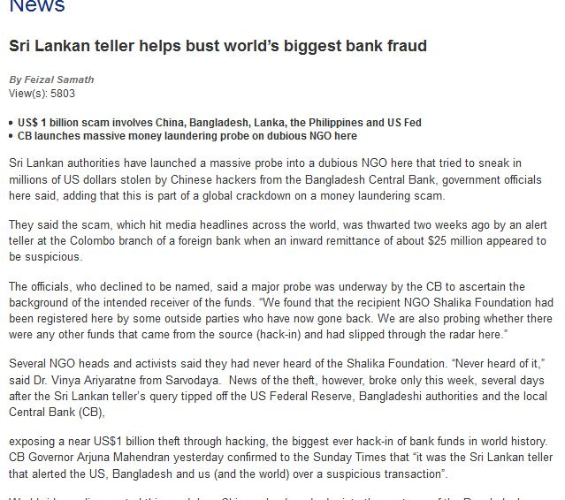
“Cybercrime Challenges for Sri Lanka”
“Multi-National Nature, Tracing e-Evidence – Options”

Slide 18
Cybercrime : Challenges
Multi jurisdictional Nature
  Actions of criminals affects victims in many other countries
  Where was the offence committed?
  Which Country has jurisdiction?
  Evidence in multiple countries (“Evidence in the Cloud”) – Speed of MLA Requests?
  Jurisdiction does not exist for Cyber criminals
  Speed of International Cooperation essential factor!!
Global Standard to address these challenges??

Slide 19
Budapest Cybercrime Convention
Privacy Safeguards – Investigation & gathering Electronic Evidence
Criminalising conduct
Illegal access
Illegal interception
Data interference
System interference
Misuse of devices
Fraud and forgery
Child pornography
IPR-offences
+
Procedural tools
Expedited preservation
Search and seizure
Interception of computer data
+
International cooperation
Extradition
MLA
Spontaneous information
Expedited preservation
MLA for accessing computer data
MLA for interception
24/7 points of contact
Harmonisation

Slide 20
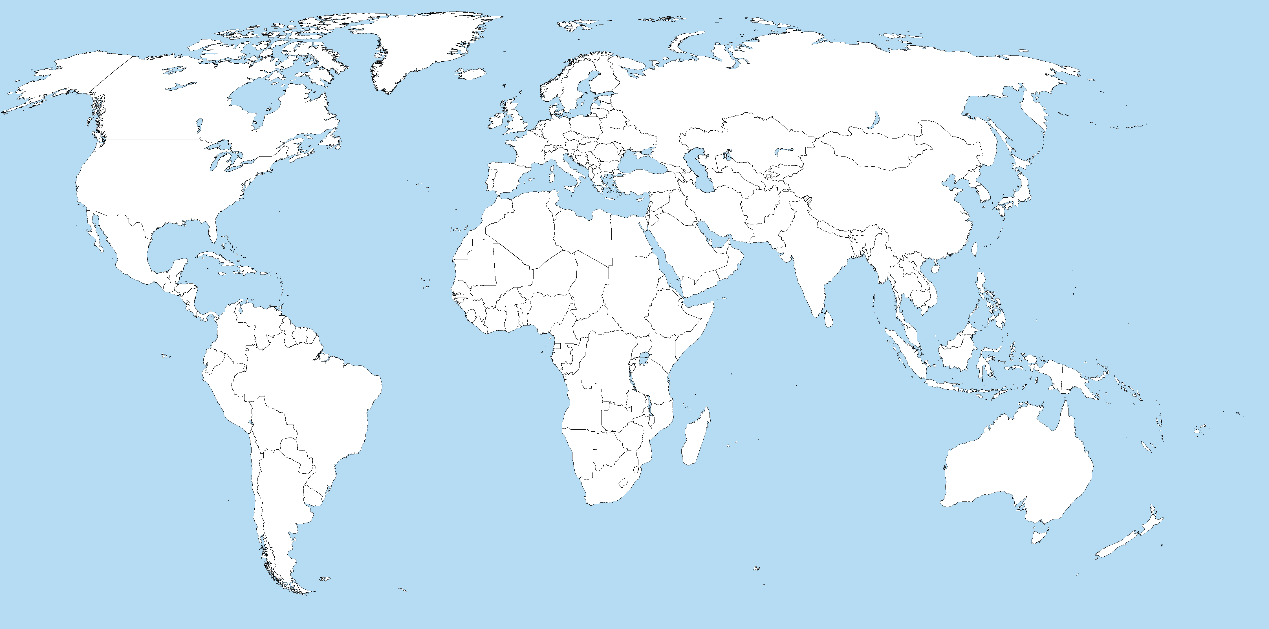
Budapest Cybercrime Convention –
Global Influence…
Canada, July 2015
Sri Lanka, May 2015
150+
Ratified/acceded: 64
Other States with laws/draft laws largely in line with Budapest Convention
Invited to accede: 9
Total = 73
States drawing on Budapest Convention for legislation
Source –Council of Europe ww.coe.int/cybercrime

Slide 21
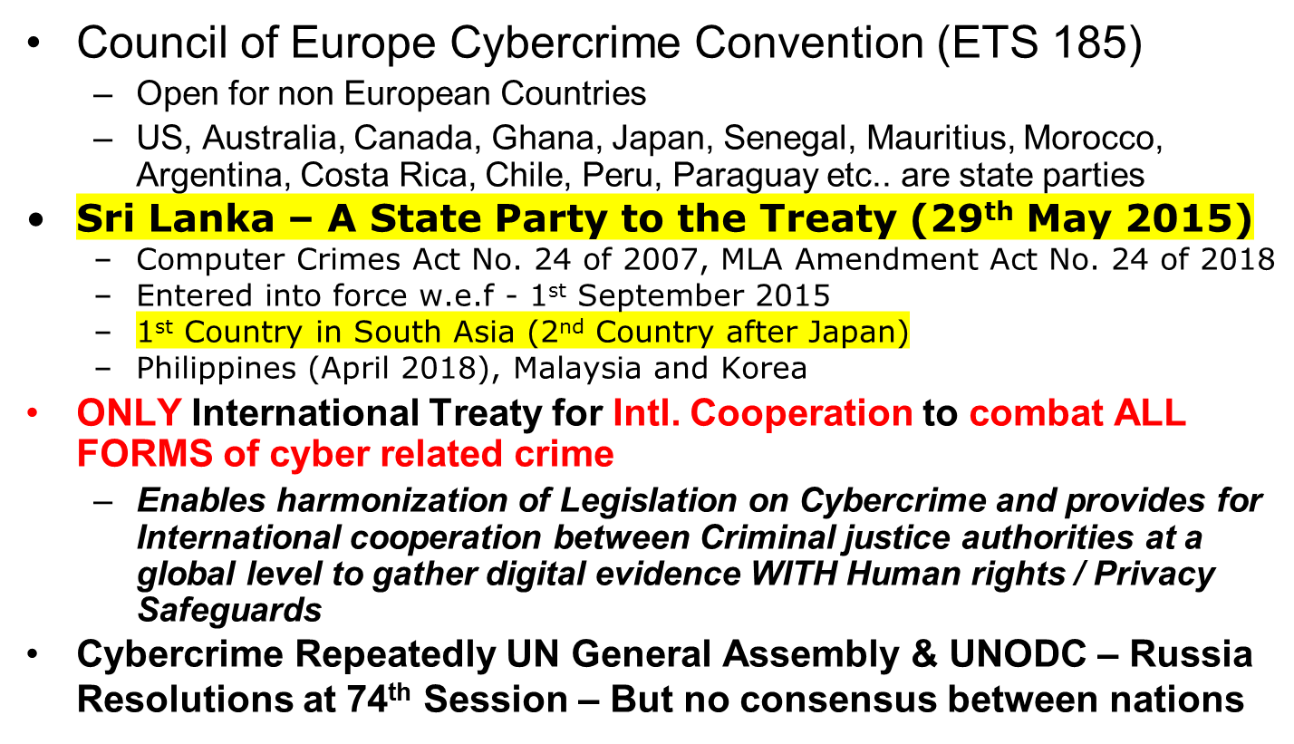
  Cybercrime – No UN Convention Yet?
  “But we have a global standard”

Slide 22
2019-20: Stronger role of the Cybercrime Convention Committee (T-CY)
Guidance Notes
Common understanding of the Parties on how to apply the Convention and address new phenomena
Guidance Notes Adopted so far:
“botnets”,
“distributed denial of service attacks”
“identity theft and phishing in relation to fraud”
“critical information infrastructure attacks”
“new forms of malware”
“transborder access to data (Article 32)”
“spam”
Article 18 – Production Orders –
Negotiation of Draft New Protocol – Cloud Evidence
The Budapest Convention remains relevant even if technology and crime evolve
www.coe.int/cybercrime

Slide 23
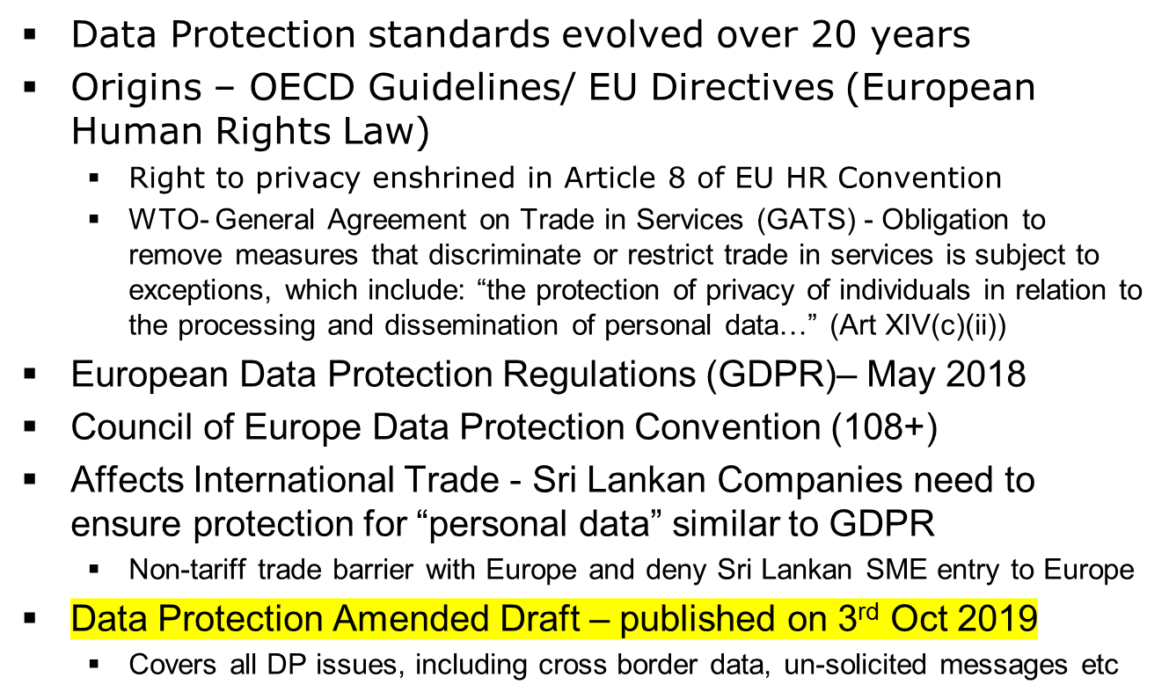
Data Protection/ Privacy
Impact of International Standards

Slide 24
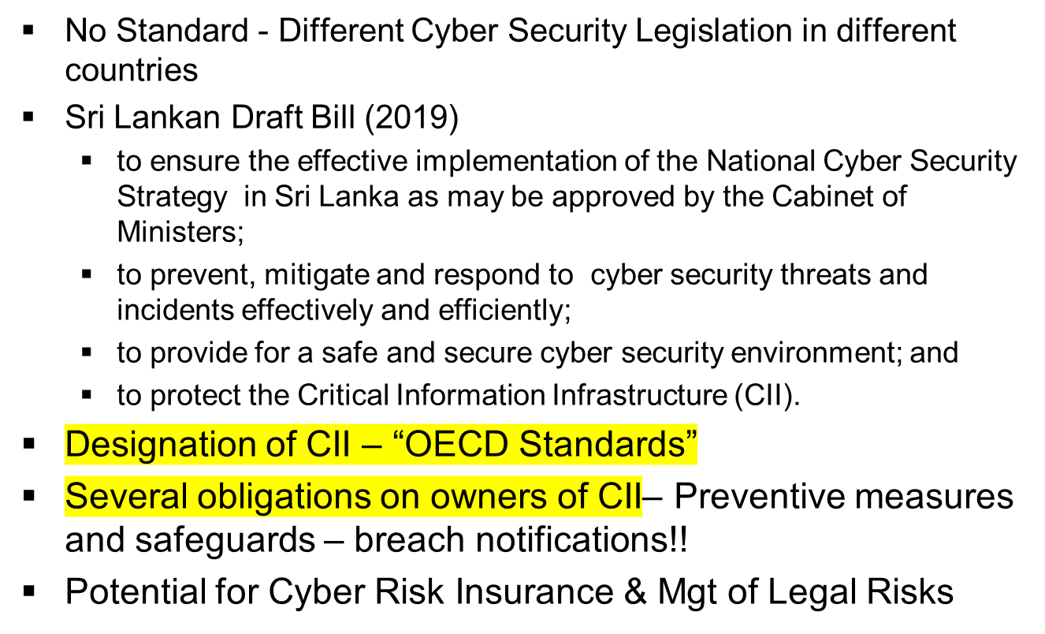
Cyber Security Legislation
International Standard?

Slide 25
  Conclusions
Different levels of maturity on “International Standards / Norms” in Digital Law related Subjects
  Digital Commerce and Transactions
  Cybercrime / Privacy
Internet & policy have become points of international conflict among nation states similar to global trade & environmental policy – no consensus
Sri Lanka has adopted several Intl. Standards
  Sri Lanka now being used as a reference point on digital laws
  We should remain neutral in International frontiers
Process of reforms continue to evolve and we need to continue to adopt “gold” standards – Are we Ready?

Slide 26
Thank You !
JFDO@icta.lk & Jayantha.fdo@gmail.com
www.icta.lk

